Slide 1
Football Players Data Exploration
and Performance Analysis
Advanced ML Course
Notes:
Note:
1

Slide 2

Agenda
Introduction
Problem Statment
Goals
Understanding Data
Data Prepreocessing
EDA
Modelling
Business solution and conclusion
Samsung Innovation Campus
Notes:
Note:
3

Slide 3
Introduction
"In the world of football, success is a blend of artistry and strategy. It's about finding hidden gems and nurturing them into stars, all while balancing the acquisition of established talent. Join us on a data-driven journey through the beautiful game, where insights meet action, and the future of football is shaped."
Samsung Innovation Campus
Notes:
Note:
2

Slide 4

01
Problem Statment
Samsung Innovation Campus
Notes:
Note:
2

Slide 5
The Challenge ...
Football Player Scouting and Analysis
“Making Informed Decisions in a Dynamic Sport”
High Expenditure: Clubs spend heavily on expensive players.
Lack of Emerging Talent: There's a need for nurturing young talents.
Balancing Investments: Striking a balance between established and emerging players is essential.

Slide 6
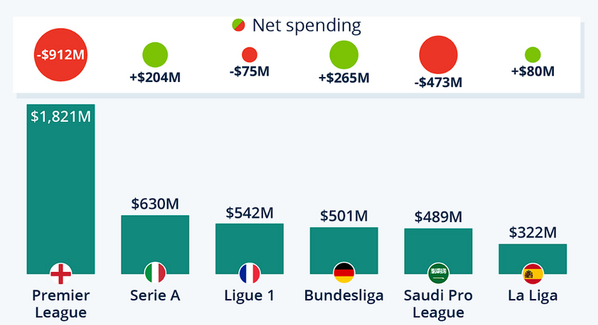
Examples
Football Player Scouting and Analysis
"Saudi clubs have made headlines with their record-breaking spending, rivaling Europe's top leagues. But as we delve deeper, we'll uncover a crucial aspect often overshadowed by these massive investments: the vital role of scouting talent."

Slide 7
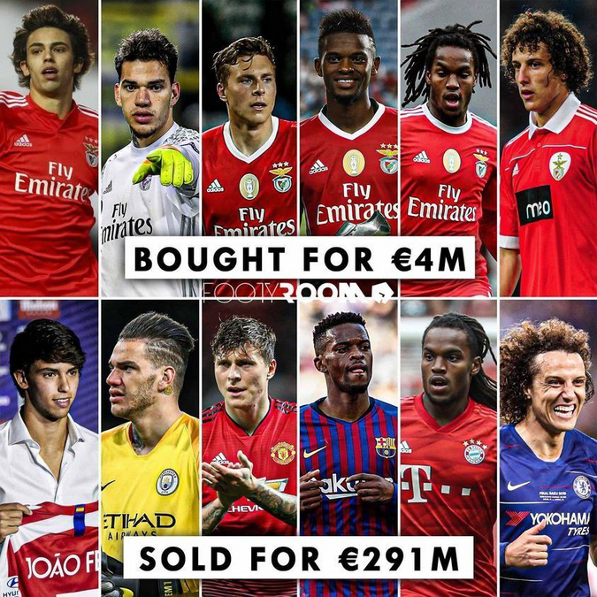
Examples
Football Player Scouting and Analysis
“The Role of Scouting “

Slide 8

02
Goals
What want to achieve at the end
Notes:
Note:
2

Slide 9
Driving Data-Backed Decision Making
Our primary goal is to provide actionable insights to football clubs.
We aim to identify promising talents, predict player performance, estimate market value, and assess injury risk.
We strive to empower clubs with data-driven strategies for scouting and player management.

Slide 10

03
Data Overview
Notes:
Note:
2

Slide 11
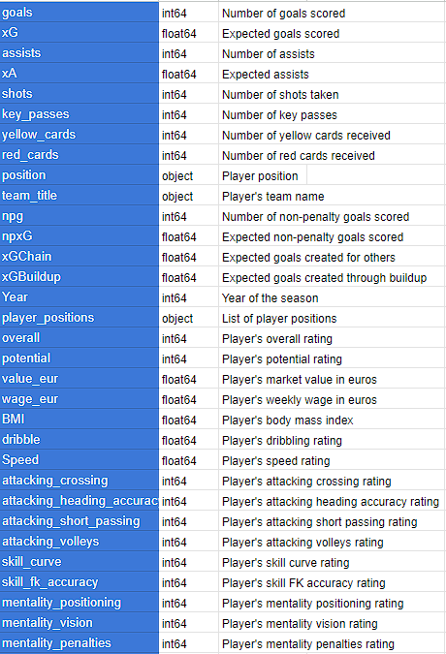
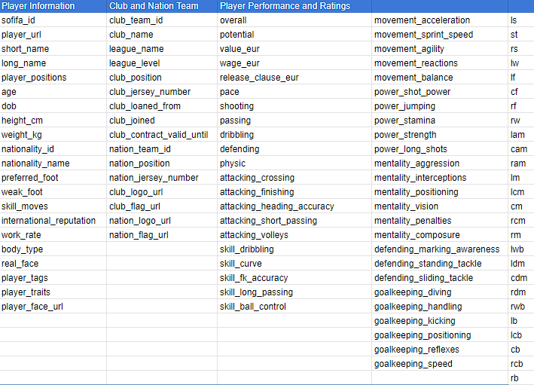
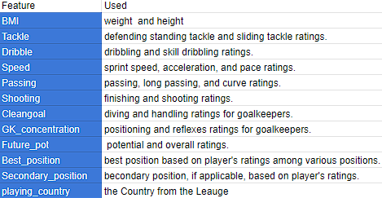
The Story of Our Data
Player Char
Raw Data
Feature Engineering

Slide 12

04
Data-preprocessing
Samsung Innovation Campus
Notes:
Note:
2

Slide 13
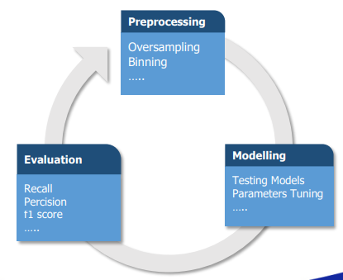


Preprocessing And Modeling
Scaling
Encoding
Handling missing values
Linear Regression
Mean absolute error
XGBoost
Score
Prophet
Samsung Innovation Campus

Slide 14
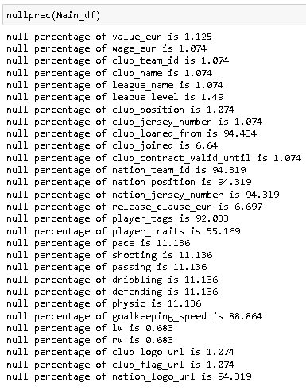
Missing values
Percent of Null Values Before Preprocessing

Slide 15
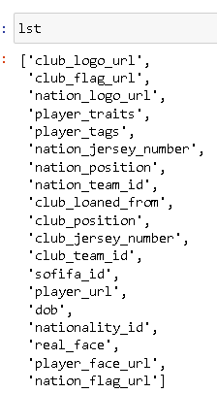
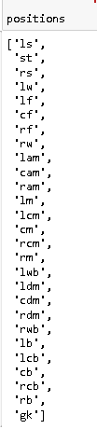
Useless columns

Slide 16
Methods to handle missing values
KNN Imputer
Null cols for goalkeepers (to 0))
Null cols for Free Agents
value_eur
shooting
passing
dribbling
defending
physic
pace
club_name
leauge_name
club_contract_valid_until
club_joined
wage_eur
release_clause_eur
Null columns for not goalkeepers players(Fill it with 0): goalkeeping speed

Slide 17
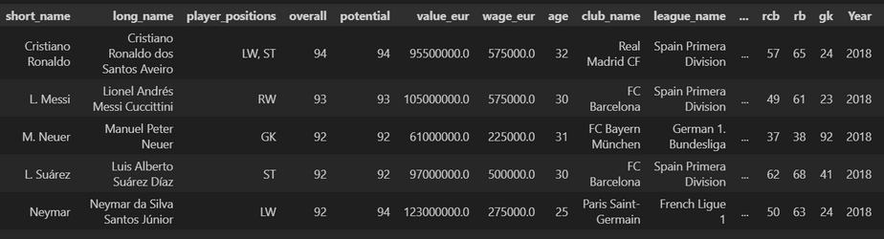
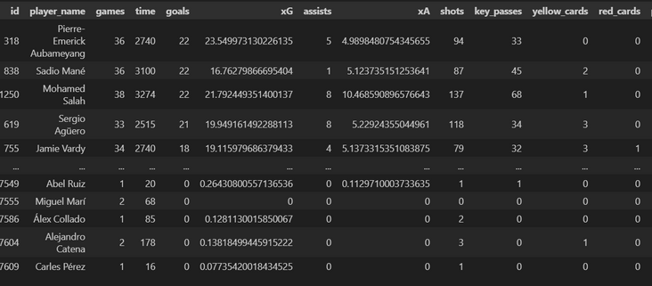
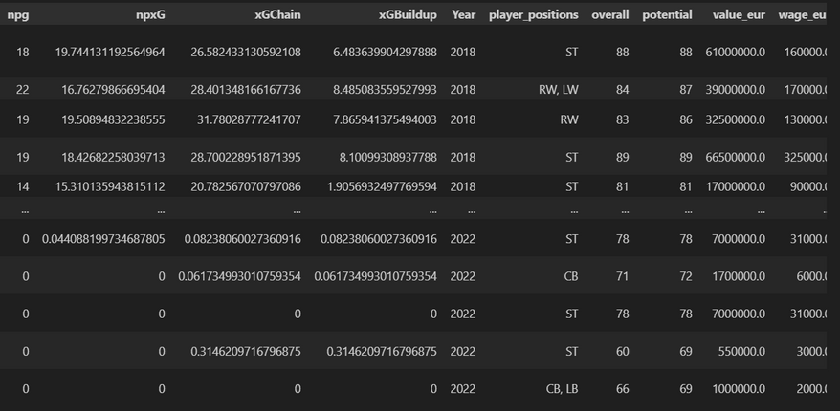
Merging two data frames :
+
=

Slide 18
Model preprocessing :
Scaling
Encoding
Robust scaler
Label encoder

Slide 19

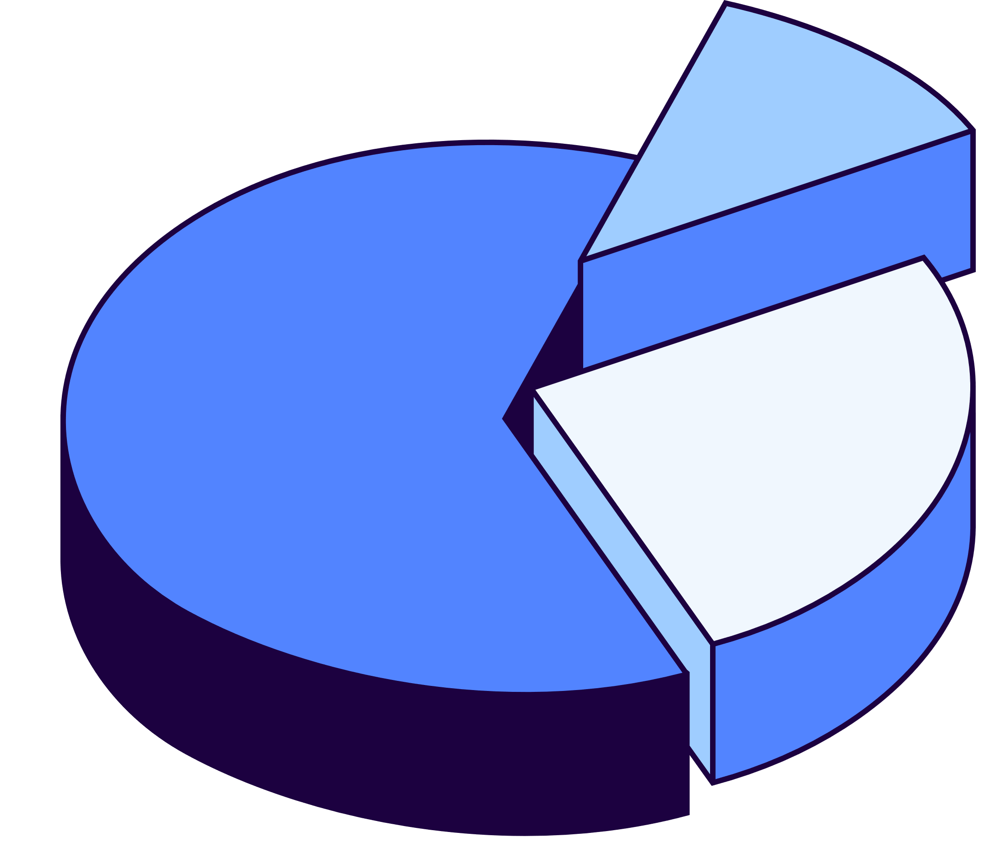
05
EDA
Notes:
Note:
2

Slide 20
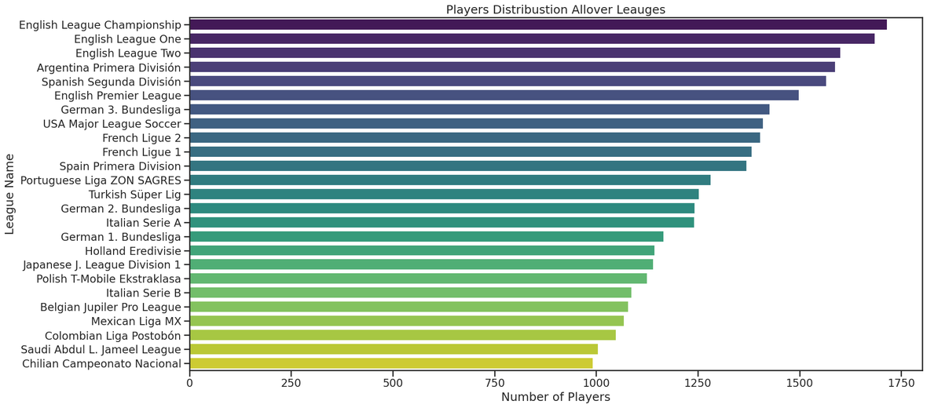
Player Distribution Across Leagues
“We can see the distribution of players worldwide to know the available markets”

Slide 21
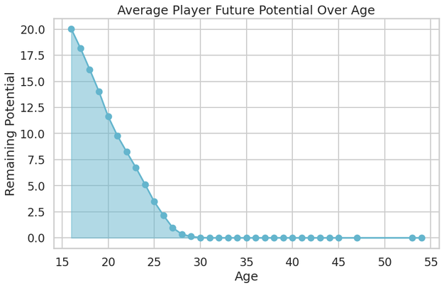
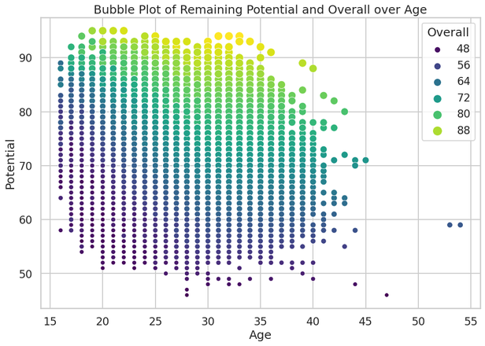
Age and Potential Dynamics in Football Players
“A comprehensive view of how a player's age relates to their potential and overall performance. Through two compelling visualizations, we gain insights into the evolving potential of football players as they age, all while considering their overall rating.”

Slide 22
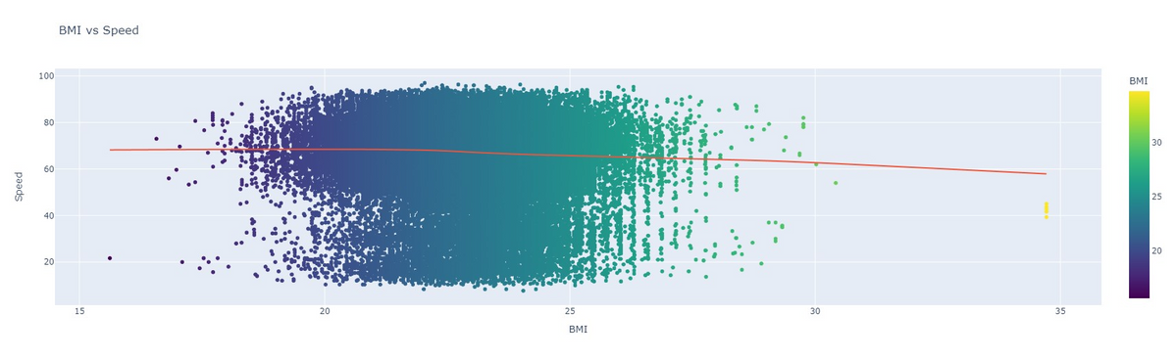
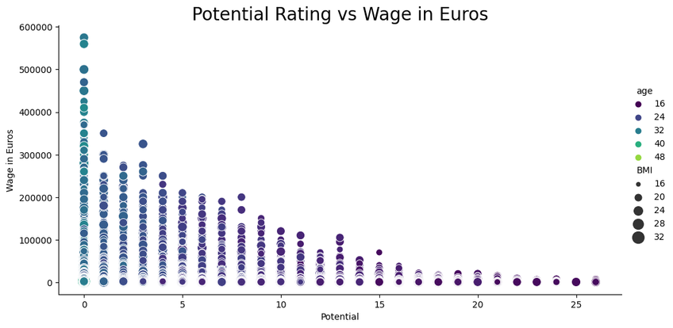
Player Distribution Across Leagues
“Player Traits & Value: We can see the relation of BMI and speed in the Player Physic and the Impact on potential and Wage ”

Slide 23
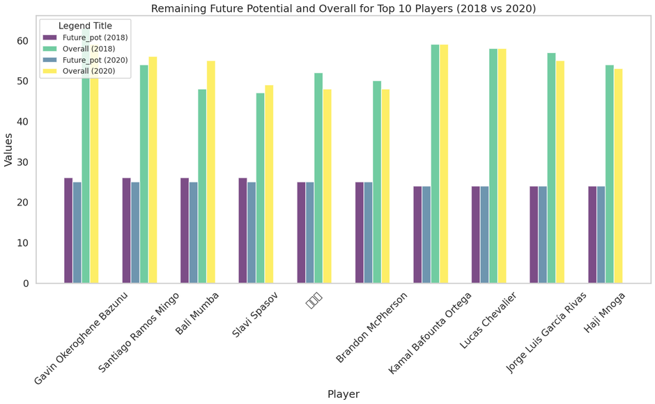
Age and Potential Dynamics in Football Players
‘’Evolving Excellence: We compare the top 10 players' Future Potential and Overall ratings in 2018 and 2020. Discover how these players have progressed over the years”

Slide 24
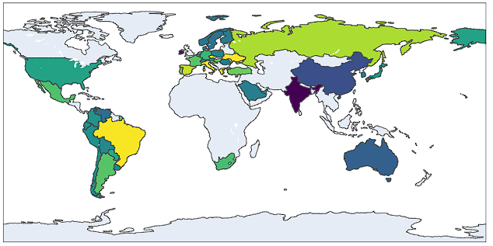
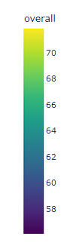
Average Overall Rating allover Leagues in 2022 Season
‘’We can see the Average Overall Rating across the players of different leagues ”

Slide 25
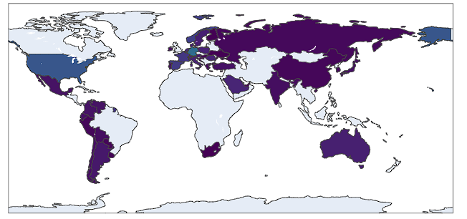
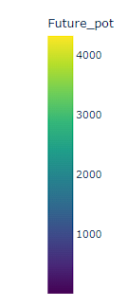
Countries with Leagues with the highest young with potential
‘’We can see the distribution of Players with High Expected Remaining Performance allover Leagues”

Slide 26
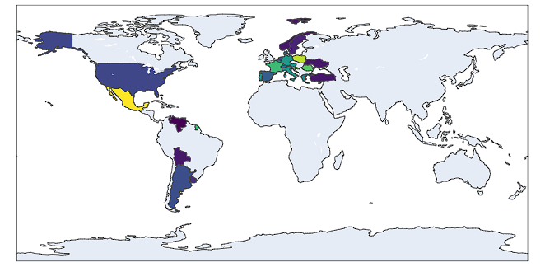
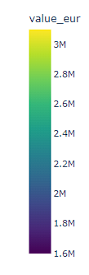
Average Value of Players with High Potential in 2022 Season by Country
‘’We can see the distribution of Players with High Expected Remaining Performance (Overall and Potential) allover Leagues in 2022 Season”
Strategic Scouting: clubs can focus their scouting on regions with many high-potential players, potentially discovering valuable talent to boost their squads and long-term performance..

Slide 27
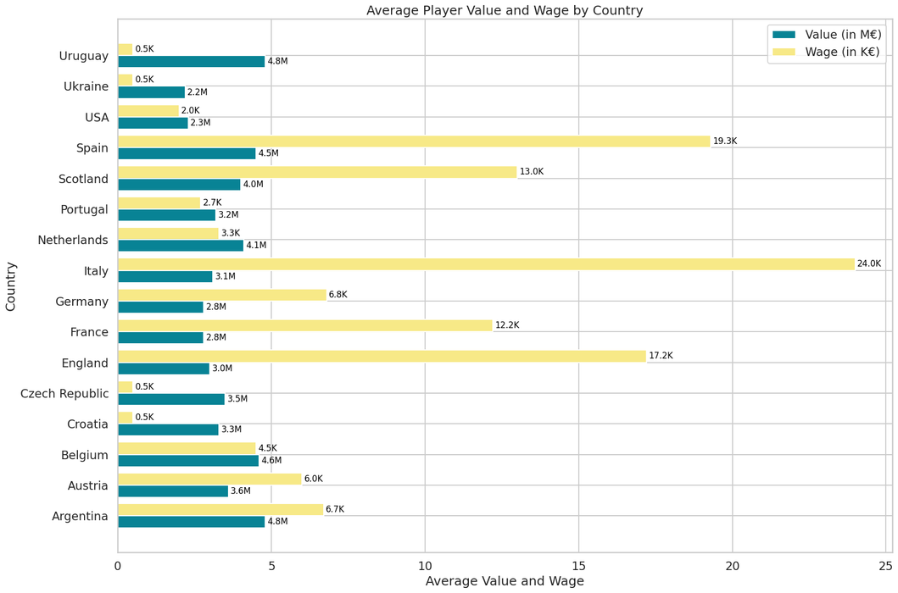
Average Player Value and Wage by Country
‘’We can see the Average Wage & Value of Players with Very High Expected Performance allover Countries”

Slide 28
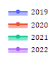
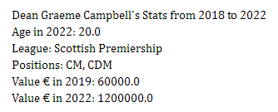
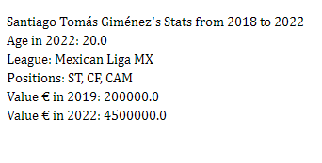
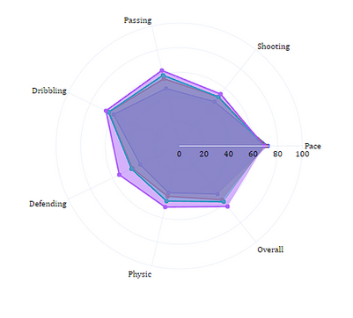
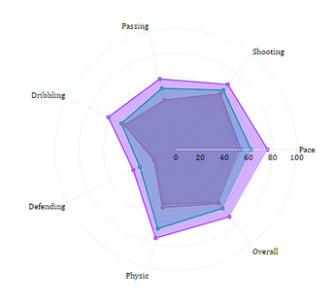
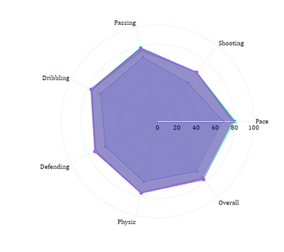
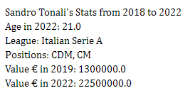
Top Young Potential Players Progress allover Years
‘’We can see a sample from the progress of the Top players with High Expected performance in 2020 ”

Slide 29
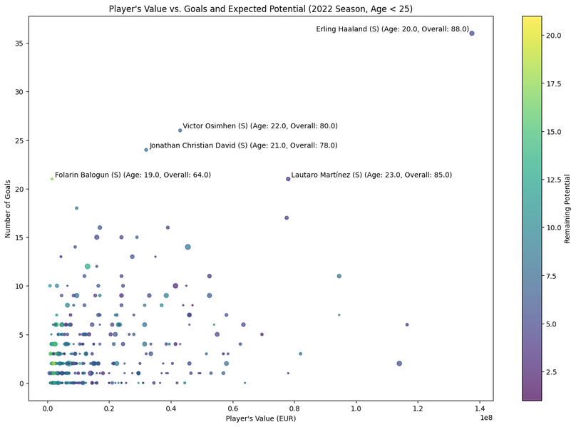
Player's Value vs. Goals and Expected Potential (2022 Season, Age < 25)
‘’We Can see here the Top Stickers progress in 2022 Season ”

Slide 30
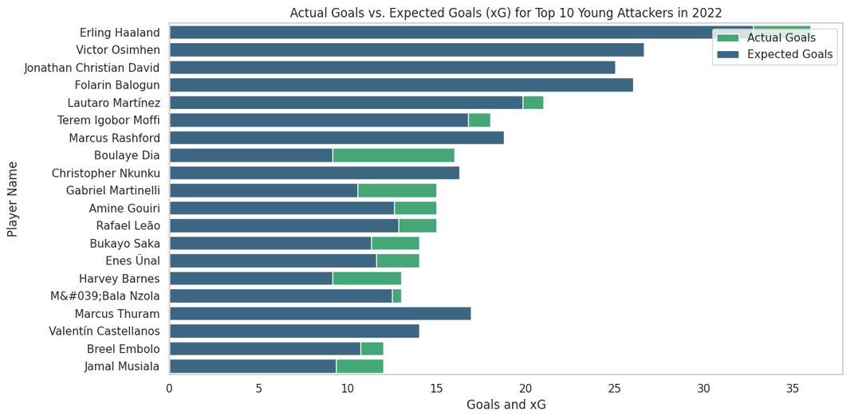
Expected Goals vs. Actual Performance for the top young Strikers
‘’We can see the Expected goals of the TOP 10 strikers in performance and statistics ”
Impact: Enhanced Striker Selection: You can make more informed decisions when selecting strikers for your squad, focusing on those with higher expected goals to boost your team's scoring potential and overall performance.

Slide 31
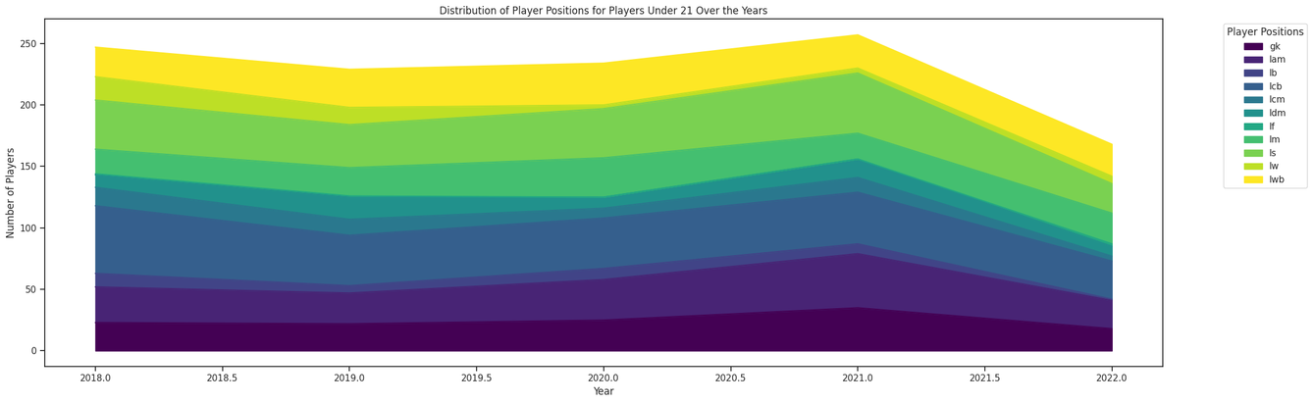
Positions of Young Players Distribution allover Seasons
“We can see a significant drop in the period after the 2021 season in the defensive positions,
In the light of this observation,
Impact: clubs could know that investment in this positions could be very useful to benefit on the long-term vision”

Slide 32
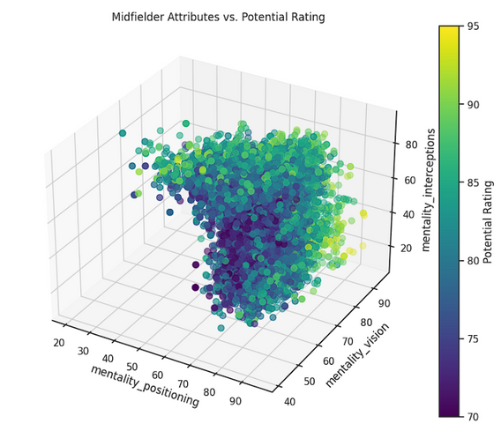
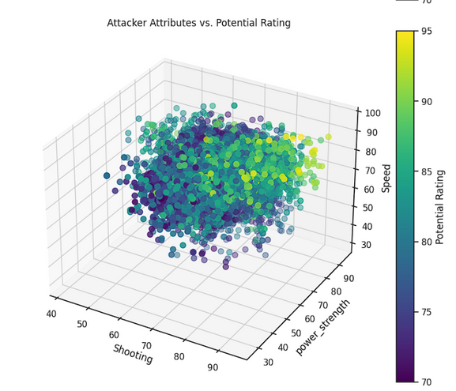
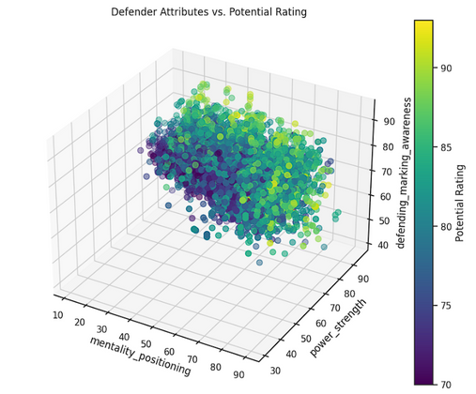
Player Position vs. Attributes and Potential Rating
“We can see the relation between some attributes related to the main 3 lines of the gameplay to try to classify the positions,
Strategic Recruitment: Clubs can optimize player recruitment by focusing on position-specific attributes for better team performance.

Slide 33

06
Testing & Modeling
Samsung Innovation Campus

Slide 34
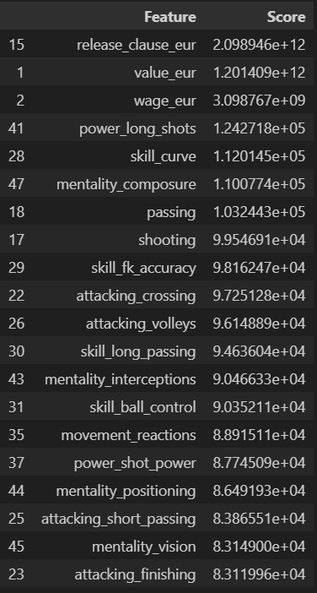
Chi squared test

Slide 35
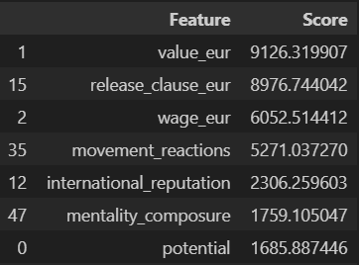
Anova test

Slide 36
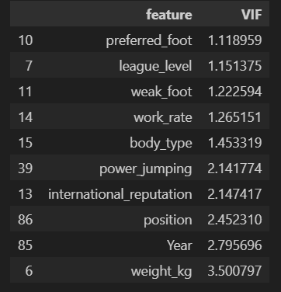
VIF test

Slide 37
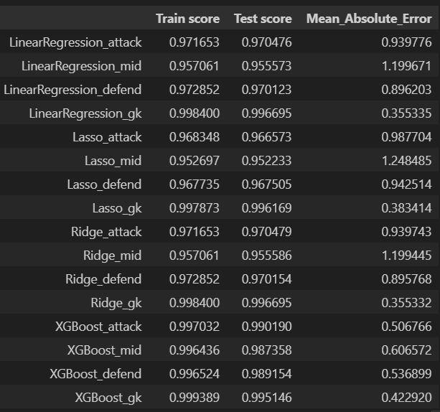

Predicting overall rating

Slide 38
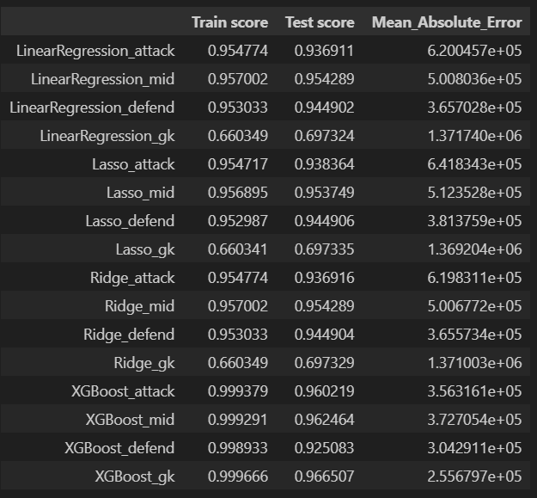
Predicting value of player

Slide 39
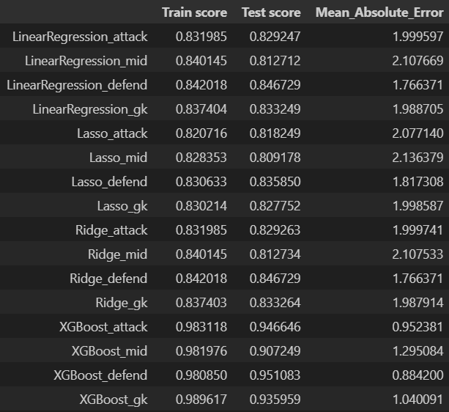
Predicting potential of player

Slide 40
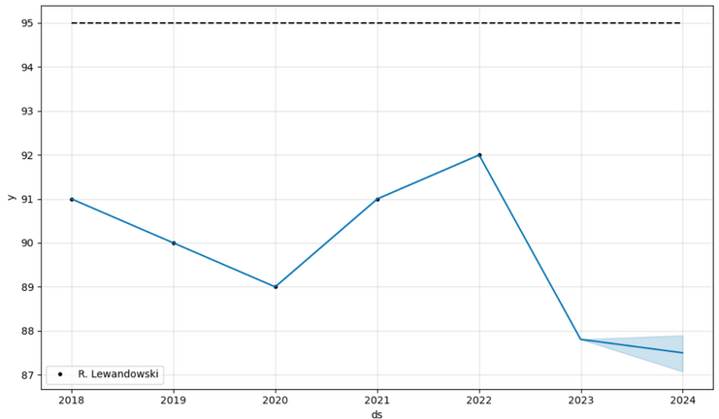
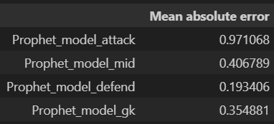

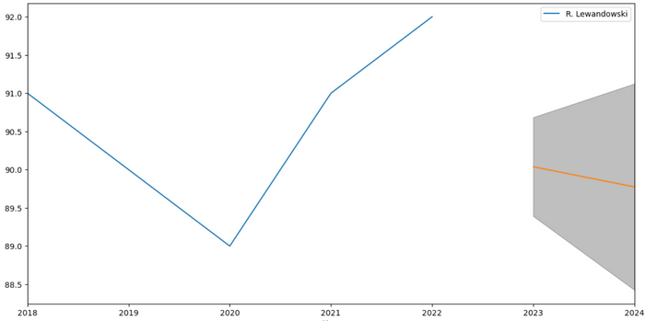
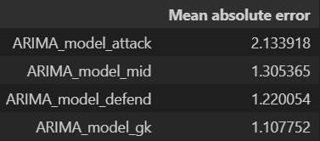
Overall future forecasting

Slide 41
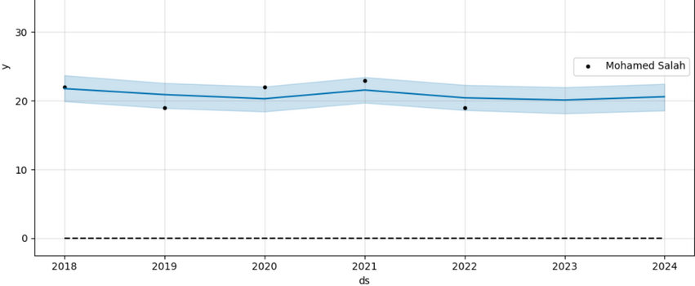



Goals and Assists forecasting

Slide 42

Injury exposure clustering

Slide 43

06
Business Solutions & Future Work

Slide 44
Modeling Oriented Business Questions
Player Recruitment: Finding the best players that fit the club’s needs by predicting their performance and potential.
Resource Allocation: Using predictions of goals, assists, and injuries to manage team resources effectively.
Player Development: Helping young players grow and succeed by predicting how their value will change over time.
Decision-Making: Using data to make informed decisions during player transfer negotiations.
Risk Mitigation: Reducing risks by identifying players who are prone to injuries.
Player Scouting: Predicting promising talents and future potential and Comparing between players features

Slide 45
Analytical Business Questions
Market Valuation: Tracking player price changes for market insights.
Performance Trends: Identifying trends for informed decisions.
Development Prospects: Assessing growth potential for player development.
Market Opportunities: Spotting undervalued players and prospects.
Monitoring player features

Slide 46



Comparative Analysis: Comparing player profiles to make data-driven decisions when choosing new signings.

Slide 47




Slide 50


